Slide 1
Priority Queue and Heap
Il-Chul Moon Dept. of Industrial and Systems Engineering KAIST
icmoon@kaist.ac.kr

Slide 2
Weekly Objectives
This week, we study various tree data structures. Particularly, we will focus on the priority queue and the heap.
Objectives are
Understanding the structures and the operations of
Priority queues and heaps
Insert, delete
Structural integrity of the data structures
How to maintain the integrity
Understanding the performance of
Priority queues and heaps

Slide 3
Detour: Performance of binary search tree
Coming from divide and conquer
 | Linked List | BST in Average | BST in Worst Case
Search | O(n) | O(log n) | O(n)
Insert after search | O(1) | O(1) | O(1)
Delete after search | O(1) | O(1) | O(1)
Traverse | O(n) | O(n) | O(n)
3
2
5
0
4
7
BST in Average
Insert 3, 2, 0, 5, 4, 7
0
2
3
4
BST in Worst Case
5
Insert 0, 2, 3, 4, 5, 7
7

Slide 4







Priority Queue
Enqueue Lee
Enqueue Lee
Enqueue Shin
Enqueue Shin
Enqueue Moon
Enqueue Moon
Enqueue Lee with Priority
Queue with priorities
Element who has priorities in the enqueue operation
Naturally, the element with the priority will be dequeued with the priority as well
In other words
Cutting in the line
VIP service
Dequeue Lee
Dequeue Lee
Dequeue Shin
Dequeue Lee
Dequeue Moon
Dequeue Moon

Slide 5
Operations of priority queues
Enqueue Lee
Previously in queues
Enqueue an element
Now in priority queues
Enqueue an element with a priority
Priority in the priority queue context
In our definition, let’s say
Higher value = higher priority
Lower value = lower priority
Then, consider the previous example
Prof. Tae Eog Lee
Priority 2
Prof. Hayong Shin, Taesik Lee, Il-Chul Moon
Priority 1
Therefore, the interface of the priority queue will be
enqueue(element, key)
Rather, enqueue(element) in queue
Enqueue Shin
Enqueue Moon
Enqueue Lee with Priority
Higher Priority
Higher Priority
Higher Priority

Slide 6
How to implement priority queues
Using the linked list as the basis of the priority queue
Store the element as well as the priority
Then, two approaches to implement the priority queue
Lazy approach == Unsorted implementation
When there is an enqueue event, just insert the element and the priority value at the end of the queue
When there is a dequeue event, remove the element with the highest priority by searching the queue from the beginning to the end
Early-bird approach == Sorted implementation
When there is an enqueue event, insert the element and the priority at the position that starts a sequence of elements with lower priorities
When there is a dequeue event, remove the element at the front of the queue
Enqueue Lee
Enqueue Lee with Priority
Dequeue Lee with Priority
Dequeue Lee
Unsorted Implementation
Sorted Implementation

Slide 7

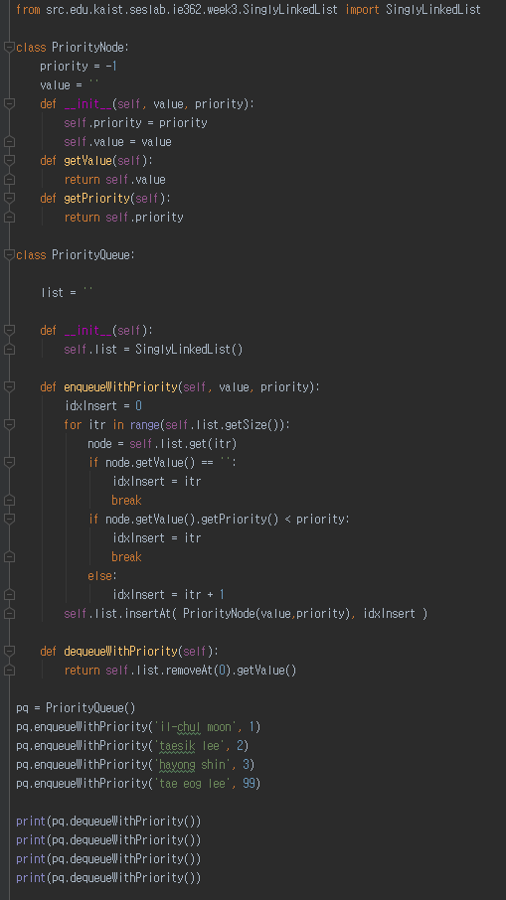


Slide 8
Implementation of priority queues
Sorted implementation
Enqueue(node, priority)
current = head
While current.next().getPriority() > priority:
current = current.next()
Index = current.getIndex()
Insert
At index
PriorityQueueNode(value, priority)
Unsorted implementation?
Have to change the Dequeue method

Slide 9
Performances of priority queue implementations
 | Enqueue = Insert | Dequeue = Delete Highest Priority | FindMax = Find highest Priority
Unsorted Implemen-tation | O(1) | O(n) | O(n)
Sorted Implemen-tation | O(n) | O(1) | O(1)
Tree-based Implemen-tation | O(log n) | O(log n) | O(1)
3
2
5
0
4
7
Balanced Tree
0
2
3
4
5
Only true under the assumption that the tree is balanced…
Unbalanced Tree
7

Slide 10
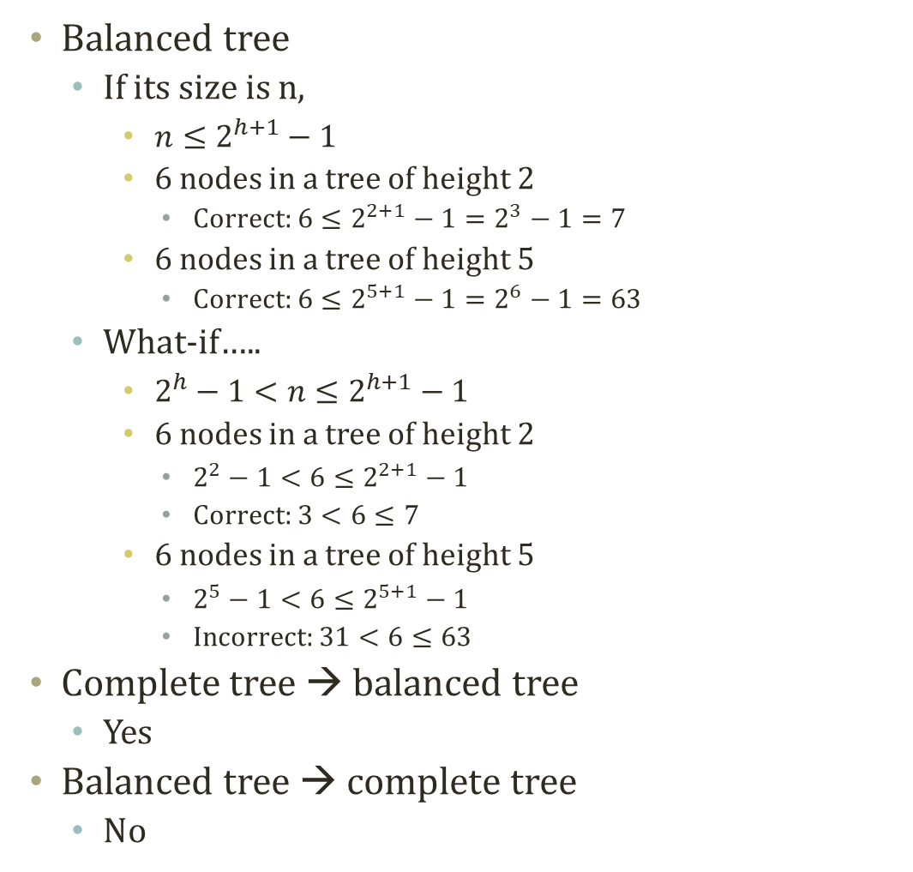
Balanced tree?
Balanced tree
If its size is n,
$n≤2^{h+1}−1$
6 nodes in a tree of height 2
Correct: $6≤2^{2+1}−1=2^{3}−1=7$
6 nodes in a tree of height 5
Correct: $6≤2^{5+1}−1=2^{6}−1=63$
What-if…..
$2^{h}−1<n≤2^{h+1}−1$
6 nodes in a tree of height 2
$2^{2}−1<6≤2^{2+1}−1$
Correct: $3<6≤7$
6 nodes in a tree of height 5
$2^{5}−1<6≤2^{5+1}−1$
Incorrect: $31<6≤63$
Complete tree → balanced tree
Yes
Balanced tree → complete tree
No
3
2
5
0
4
7
Balanced Tree
0
2
3
4
5
Unbalanced Tree
7

Slide 11
Binary heap for priority queue
3
2
5
Priority queue implementation
Linked list based implementation
Sorted implementation
Unsorted implementation
Tree based implementation
Tree should be balanced to justify the reason of using trees
Binary heap is a binary tree with two properties
The shape property
The tree is a complete tree
The heap property
Each node is greater than or equal to each of its children
Max-heap since we defined a higher priority has a higher value
0
4
7
Is this tree a max-heap?
3
2
5
0
4
7
Is this tree a max-heap?
7
4
5
0
2
3
Is this tree a max-heap?

Slide 12
Structure of binary heap using reference
Root
99
Complete tree
19
36
17
3
25
1
2
7
1
A position for the next node
Size 11, 3rd Leaf counting from 0 (011: Left, Right, Right)
O(log n) to reach this node

Slide 13
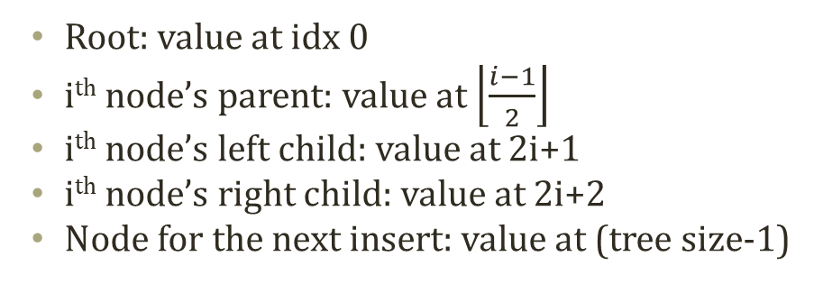
Structure of binary heap using array
Root: value at idx 0
i^{th} node’s parent: value at $\left\lfloor \frac{i−1}{2}\right\rfloor$
i^{th} node’s left child: value at 2i+1
i^{th} node’s right child: value at 2i+2
Node for the next insert: value at (tree size-1)
index | value
0 | 99
1 | 19
2 | 36
3 | 17
4 | 3
5 | 25
6 | 1
7 | 2
8 | 7
9 | 1
10 | Next to Insert
99
19
36
17
3
25
1
2
7
1
Size 11, Index 10, O(1) to reach this node

Slide 14
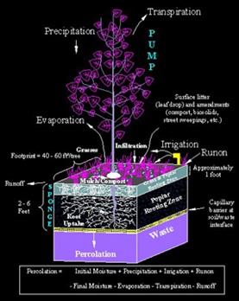
Insert operation of binary heap
Insert of binary heap, a.k.a. Percolate-up
Starting from a leaf
Approaching toward a root
How to?
Insert a value at the next node to insert
Compare the value to the value of the inserted node’s parent
If the value is bigger than the parent’s
The heap property is broken
Exchange the two values
Repeat this comparison at the parent’s node
One level Percolate up
Need Recursions
99
99
19
36
19
36
17
3
25
1
17
70
25
1
2
7
1
70
2
7
1
3

Slide 15
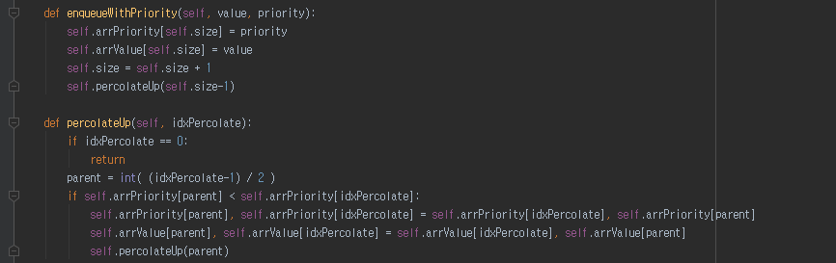
Implementation of insert of binary heap
No percolation!
99
99
70
36
70
36
17
19
25
1
17
19
25
1
2
7
1
3
2
7
1
3

Slide 16
Delete operation of binary heap
Delete of binary heap, a.k.a. Percolate-down or cascade-down
Starting from a root
Approaching toward a leaf
How to?
Delete the root node value by replacing the node with the last node
Compare the value to the value of the inserted node’s children
If the children’s value is bigger than the parent’s, (pick a bigger child)
The heap property is broken
Exchange the root value and the bigger value from children
Repeat this comparison at the exchanged child’s node
Exchange with the last element
99
1
19
36
19
36
17
3
25
1
17
3
25
1
2
7
1
2
7

Slide 17
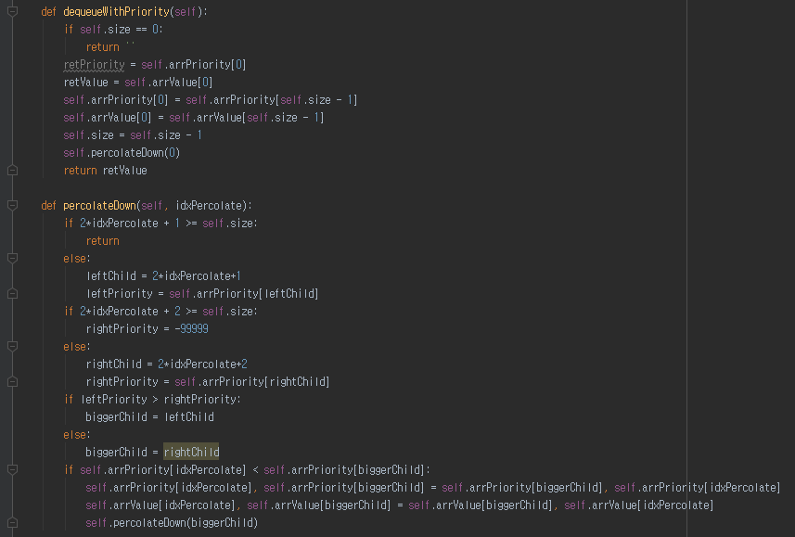
Implementation of delete of binary heap
36
Percolate the value from the root to a leaf
36
19
1
19
25
17
3
25
1
17
3
1
1
2
7
2
7

Slide 18
Complexity of priority queue, again
 |  | Build | Enqueue = Insert | Dequeue = Delete Highest Priority | FindMax = Find highest Priority
Unsorted Implementation |  | O(N) | O(1) | O(N) | O(N)
Sorted Implementation |  | O(N²) | O(N) | O(1) | O(1)
Binary Heap | Reference based | O(NlogN) | O(logN) | O(logN) | O(1)
 | Array based (Naive build) | O(NlogN) | O(logN) | O(logN) | O(1)

Slide 19
Heap sort
Priority queue
Repeated, dequeue with the highest priority
= dequeue the maximum value
Well-utilizable for sorting
Particularly
Binary heap enables the dequeueing with O(logN)
For dequeueing all elements, it takes O(NlogN)
Same to the sorting all of the elements
How to perform a sorting with a heap (= heap sort)
Given a list whose index ranges from 0 to N
Firstly, Consider it as an insert to the heap from an array = O(NlogN)
It is the same problem of building a binary heap
Secondly, take out one element at a time = O(NlogN)
For itr in range(0, N):
Sorted[itr] = Heap.getHighestPriority()

Slide 20
Further Reading
Introductions to Algorithms, 2nd ed., by Cormen et al.
pp. 455-475

Slide 21
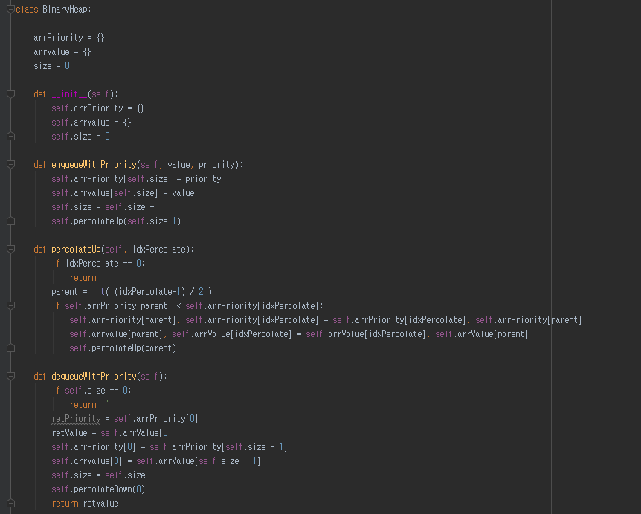
Implementation of binary heap using array (1)

Slide 22
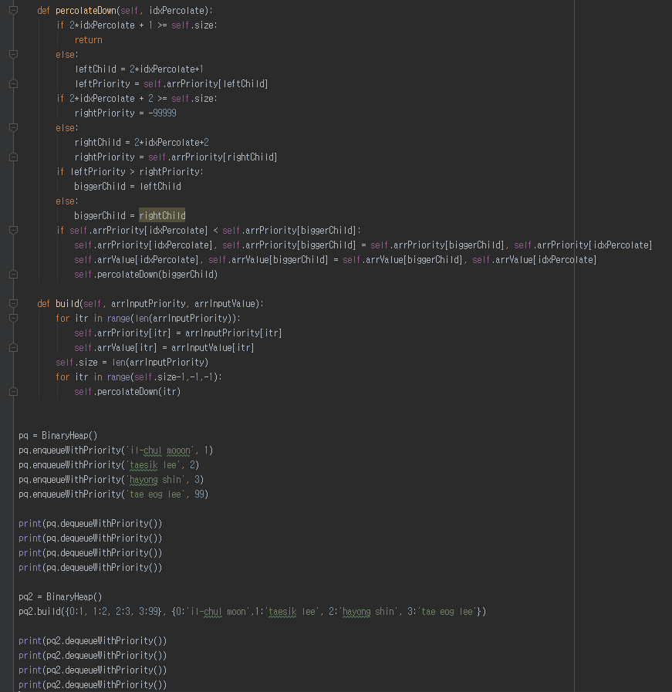
Implementation of binary heap using array (2)

